Slide 1

Content Distribution Network
with Web Application Firewall
(CDN with WAF)
Team Member:
Anand Sanmukhani
Berk Gur
Hao "Edward" Xu
Samit "Jade" Dhangwattanotai
Xuanhao Mi
Notes:
Jade

Slide 2
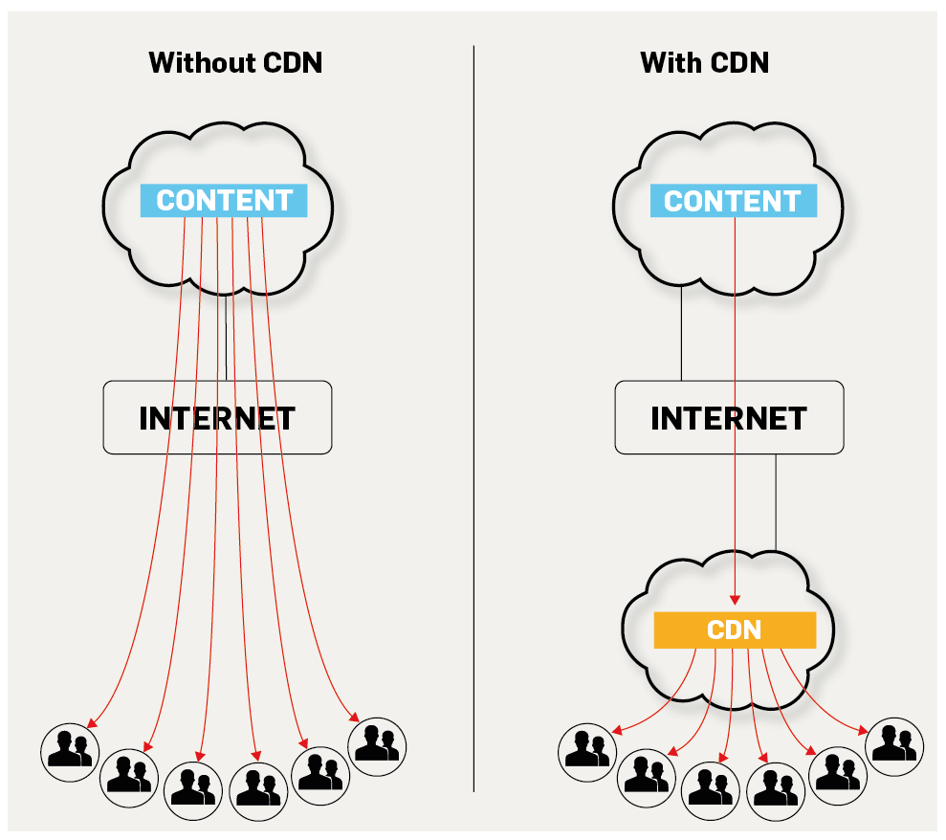
Project Overview
The aim of our project is to design and develop our own version of a CDN with an emphasis on cyber security.
Motivation: CDNs can help users load websites faster by serving your static resources in nodes. Ensuring a faster response and content download time due to reduced latency.
Also, this helps to balance the load on a single server to multiple caching servers
Supervised by Akamai Technologies : Karl Redgate
Notes:
Jade

Slide 3
What is a CDN? Why is it so crucial nowadays?
Features of our system:
Use virtual machines instances on MOC OpenStack to simulate the origin server
Dynamically balance workload across multiple computing resources
Customize our own DNS services to guarantee best fetching speed for clients
Develop firewall to filter and track cyber attacks
Provide REST API to the clients for managing servers
Provide visual interface for demo purposes, developed in React.js
Notes:
Edward

Slide 4
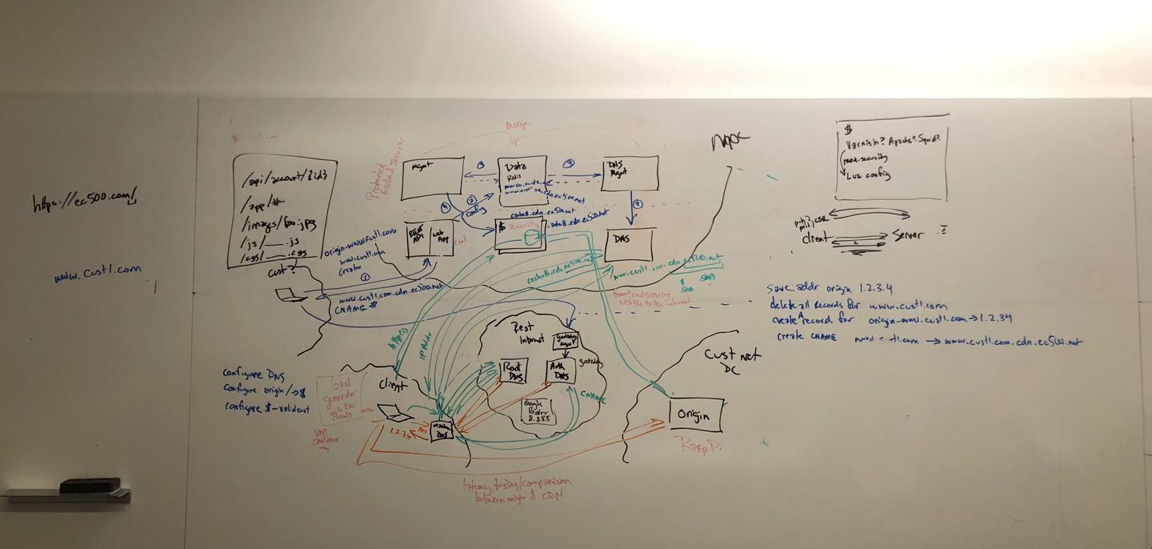

Slide 5
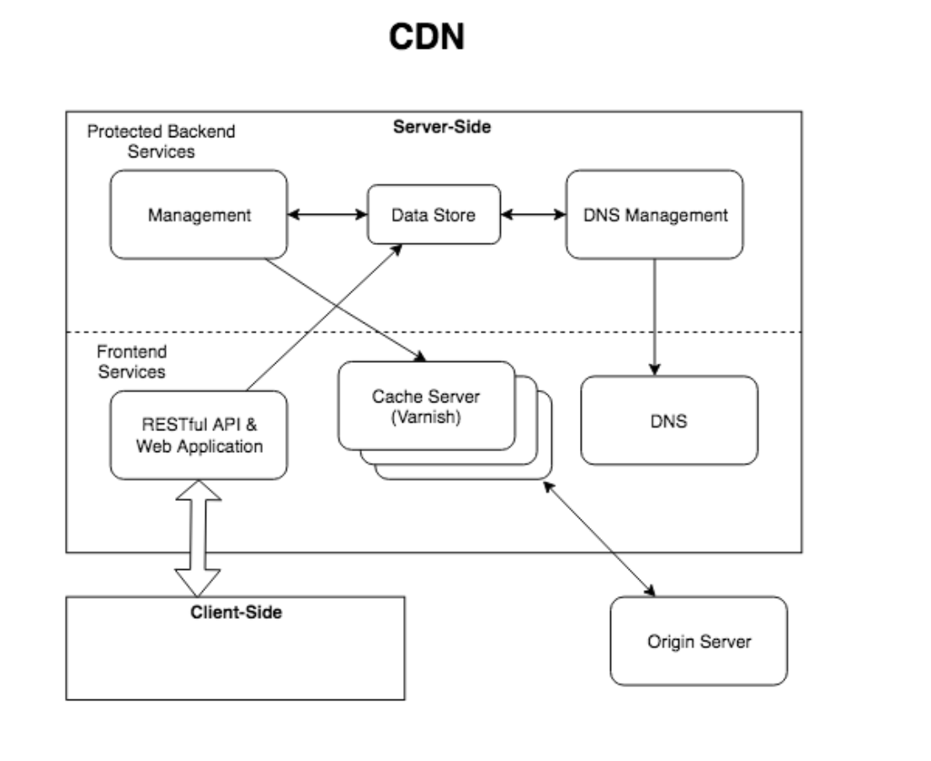
Initial Solution Architecture
Notes:
Anand
Different Components:

Slide 6
Demo Plan
Demonstrate Web user interface to display back-end modules and processes.
Basic user management functions without infrastructure (Deliverable 1)
Data Store Server (Deliverable 2)
Management and DNS Management Server (Deliverable 2)
Demonstrate client-side usage with Cache access.
Without load balancing (Deliverable 3)
With load balancing but without security layers (Deliverable 4)
With security layers (Deliverable 5)
Load Scaling Demonstration (autoscale) (bonus)
Notes:
Berk
Usere doesnt need infastructure

Slide 7
User Stories
As a website visitor , I would like low latency of this website, so that I can save my time and enjoy my free time.
As a website owner, I would like low latency for website visitors in different area, so that my website will be more competitive and get more customers.
As a website owner, I would like the CDN has clear API and intuitive UI design, so that I can use this CDN service simply and efficiently.
As a website owner, I would like the CDN has firewall to filter and track cyber attack, so that my website can be safe while using this CDN service.
Notes:
Mi

Slide 8
On going discussion..
REST API: Flask vs. Django (Leaning towards Django?)
NGINX - Intering features. (If use as cache)
TLS Support

Slide 9
Thank you, Questions?

